Slide 1
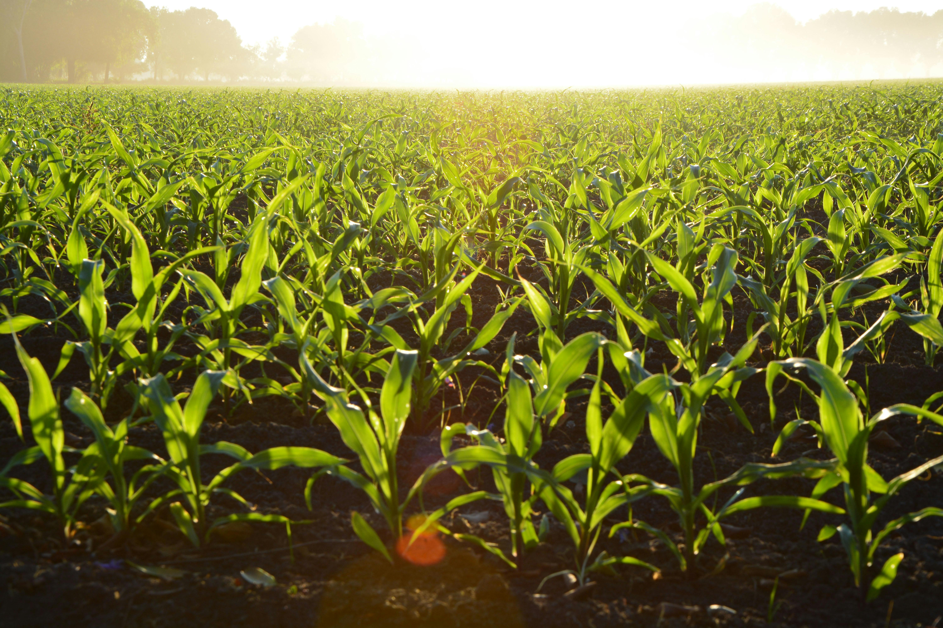
USDA PLANT
HARDINESS ZONES
Climate Change and Impacts on Agricultural
Crops in the Kentucky-West Virginia-Ohio Region
Megan Howard – Cohort 11
Notes:
Hello everyone, my name is Megan Howard, and today I’m going to talk about something that affects every farm, garden, and landscape in our region — how climate change is shifting the USDA Plant Hardiness Zones and what that means for agriculture in Kentucky, West Virginia, and Ohio.
We’ll look at how these shifts connect to changes in temperature and rainfall, what the data tells us about trends and future predictions, and how these changes are already influencing crops like corn and soybeans.

Slide 2
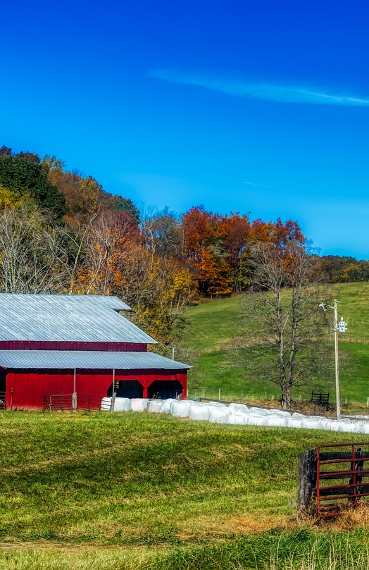
Goals
Explain USDA Growing Zones and their use in farming and agriculture
Examine temperature trends that have spurred recent change in zones
Predict future temperature patterns
Look at crop impacts in tri-state region
Notes:
My main goals for this project are to look at how the USDA growing zones are shifting — what’s driving those changes, and what that means for agriculture in our region. I wanted to connect the temperature and rainfall data we’ve seen to those zone changes and think about what the next few decades might look like.
I am also really interested in the local impact — specifically here in the tri-state region, where farming and gardening are such a big part of community life. I can relate to this on a personal level as well. I grew up here in West Virginia, and my husband has a small-scale vegetable garden that he’s been slowly turning into a business. So, looking at how weather patterns are shifting and how that affects crops isn’t just an academic question — it’s something that really matters to my family and to a lot of people in our area.

Slide 3
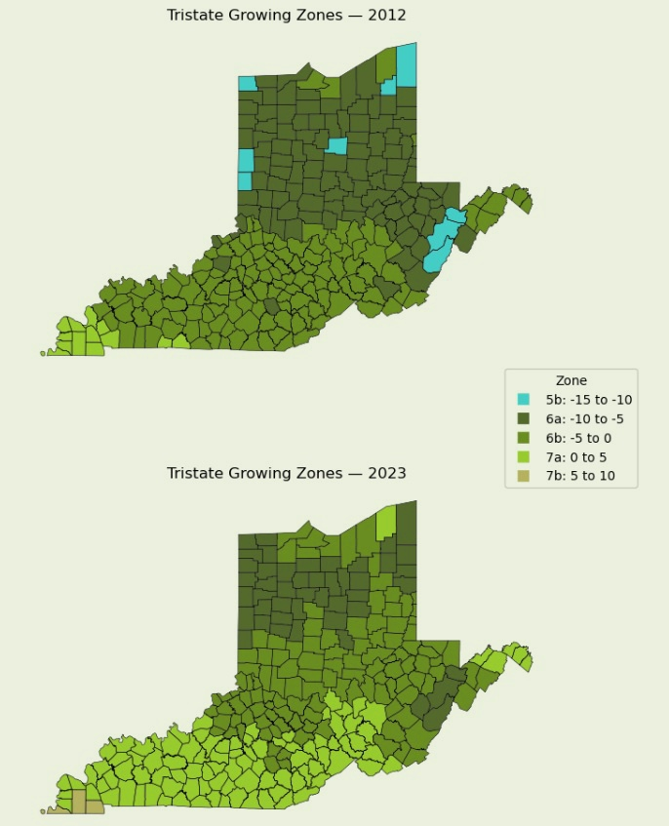
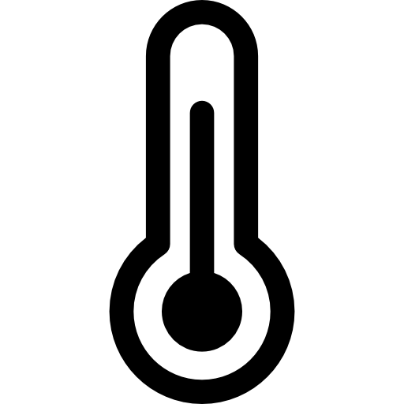


Understanding USDA Growing Zones
Based on annual extreme minimum temperatures
Help farmers and gardeners choose winter-hardy plants
Zone shifts reflect climate change over time
Notes:
The USDA plant hardiness zones are based on annual extreme minimum temperatures — in other words, the coldest days of winter. The zones are split by 10-degree ranges and then into smaller “a” or “b” categories by 5 degrees. For example – zone 6b, a common zone for the region, is based on extreme minimum temperatures of -5 to 0 degrees Fahrenheit. These zones help farmers and gardeners determine which crops or plants can survive local winters. The maps here show how the zones have shifted from 2012 to the most recent update in 2023 — you can see how the color bands, representing different zones, have moved northward.
Why is this important? Growing zones are like a roadmap for farmers — they help determine what crops can survive and when to plant them. Even a half-zone change can alter the types of crops that thrive, influence when pests emerge, or change flowering times. Tracking these shifts gives us tangible evidence of climate change — something that farmers are already feeling in real time. It connects the big picture of climate science directly to on-the-ground decision-making — from seed selection to pest management — which makes it essential for regional adaptation planning.

Slide 4

Average Temperature Increase
2.25
%
From 1990 – 2024 in tri-state region
Regional Zone Changes 2012 - 2023
47.9
%
Shifted to warmer zone
46.1
%
Unchanged
6
Shifted to cooler zone
%
Extreme Minimum Temp Increase
5.04
%
This metric is used to determine
growing zones
Notes:
What’s driving this shift? Across the tri-state region, we’ve seen about a 2.25% increase in average temperature since 1990. But what really stands out is the 5% rise in extreme minimum temperatures — those coldest winter days and nights. That’s what causes the zones to move northward.
In fact, between 2012 and 2023, nearly half of the tri-state area — 48% — shifted into a warmer growing zone, while 46% stayed the same and about 6% actually cooled slightly. That may sound small, but to farmers, it can completely redefine growing season length, pest cycles, and frost timing.

Slide 5
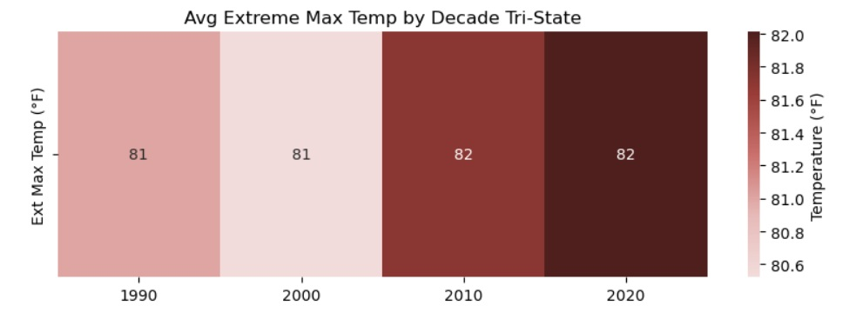
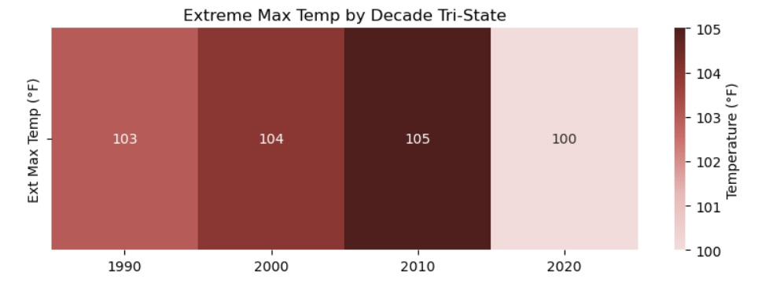
Maximum Temperature Trends
Hotter
Summers
Notes:
Let’s start with looking at maximum temperature trends across the Tri-State area over the past few decades.
The top chart here shows the average extreme maximum temperatures by decade. In other words, this looks at the hottest average temperature we tend to reach during extreme heat events. Back in the 1990s and early 2000s, that average sat right around 81°F. But by the 2010s and continuing into the 2020s, that number crept up slightly to about 82°F. It might not sound like a big jump, but even a one-degree increase in average extremes can make a noticeable difference when you’re talking about long-term climate patterns and heat waves.
Now, if we look at the lower chart, this one captures the absolute extreme maximum temperatures—essentially, the single hottest temperature recorded in each decade. There’s more variation here — from 103°F in the 1990s up to 105°F in the 2010s, and slightly cooler in the 2020s — but the overall trend shows a higher baseline for extreme heat. So summers are not necessarily breaking records every year, but they are consistently hotter and longer.

Slide 6
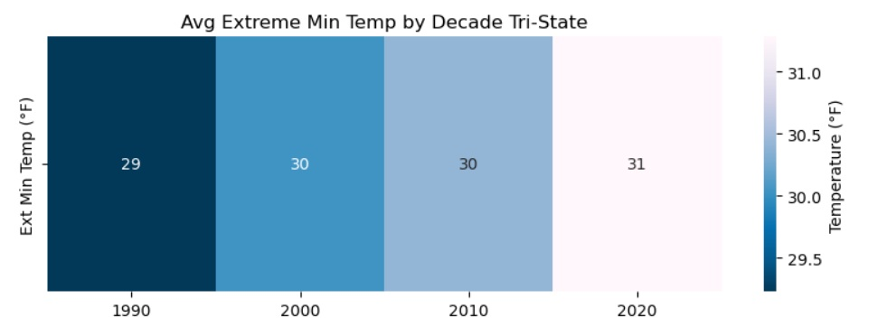
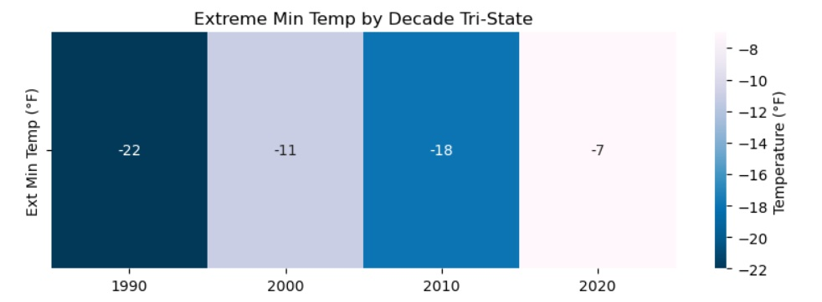
Minimum Temperature Trends
Milder Winters
Notes:
Now let’s switch gears and look at the opposite end of the spectrum — minimum temperature trends.
The chart at the top shows the average extreme minimum temperature by decade. This represents the typical coldest point we reach during extreme winter events. In the 1990s, that average was around 29°F, and it’s slowly risen over time — up to 31°F in the 2020s. Again, just a couple of degrees, but consistent increases like this suggest winters are gradually losing their sharpest cold edges.
The lower chart shows the absolute extreme minimum temperature, meaning the single coldest temperature recorded each decade. This trend is even more striking. In the 1990s, the coldest temperature hit -22°F — extremely frigid. By the 2000s, that number rose to -11°F, then -18°F in the 2010s, and only -7°F in the 2020s.
Overall, it’s clear that the region isn’t getting those deep freezes as often. These warmer minimums are a strong indicator of milder winters. While that might sound appealing at first, it can have downstream effects — for example, fewer cold snaps can influence pest populations and alter growing seasons for local agriculture.
In short, the data suggests a clear pattern: winters are warming, the coldest days aren’t as severe, and the overall temperature range between summer highs and winter lows is tightening over time.

Slide 7

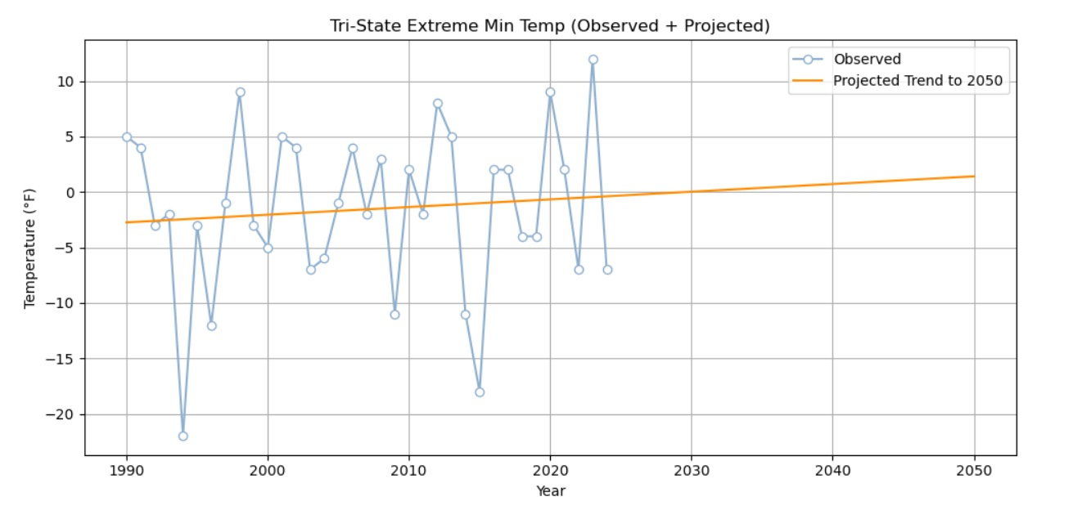
EXTREME MINIMUM TEMPERATURE PREDICTIONS TO 2050
Notes:
Looking ahead, projections show that these warming trends are expected to continue, especially when it comes to winter minimum temperatures.
On this graph, you can see both the historical data and the projected trend out to 2050. The line is gradually rising, which means that extreme cold events — like those deep freezes that used to hit every decade or so — are becoming less frequent and less severe.
By around 2050, much of the Tri-State region could actually start to resemble what we currently see in southern Kentucky’s growing zones. That shift could bring longer growing seasons, earlier planting opportunities, and potentially a wider range of crops that could be grown successfully here.
On the positive side, this could open up new crop opportunities — especially for producers looking to diversify or extend their market season. Warmer winters also reduced frost risks for some crops and can mean less winter damage overall.
But, as with most climate trends, there’s a trade-off. Warmer winters can also mean more pest and disease pressure, since colder temperatures usually help keep certain insects and pathogens in check. There’s also the concern of heat stress during summer months, and more variable weather patterns — meaning swings between heavy rainfall and drought conditions.
So, while this projected warming might sound beneficial at first glance, it also means that adaptation and resilience will become even more important — things like soil health management, water retention, and crop variety selection are going to play a bigger role in helping farmers adjust to these changes.

Slide 8

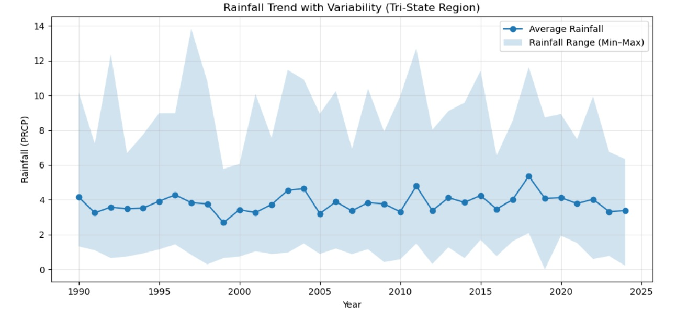
Notes:
When we look at rainfall over time, the totals themselves have been pretty steady — we’re not seeing a dramatic increase or decrease in how much rain the region gets overall.
What has changed is the consistency of that rainfall. The blue shaded area on the chart shows the range between the wettest and driest years, and you can see that it’s widened quite a bit in recent decades.
That tells us we’re experiencing more extreme swings — one year might bring excessive rain and flooding, and the next could be unusually dry. So instead of having a predictable, moderate pattern, we’re getting these back-and-forth weather extremes.

Slide 9
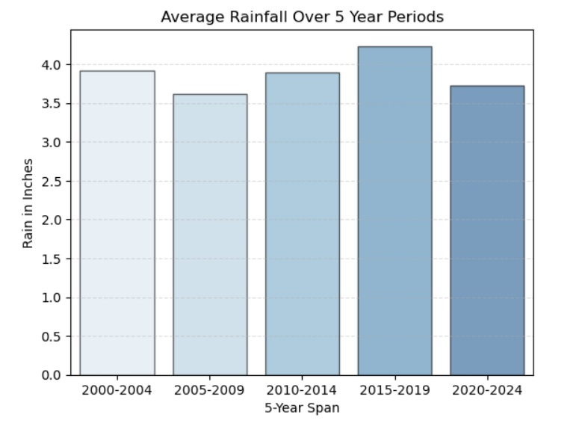
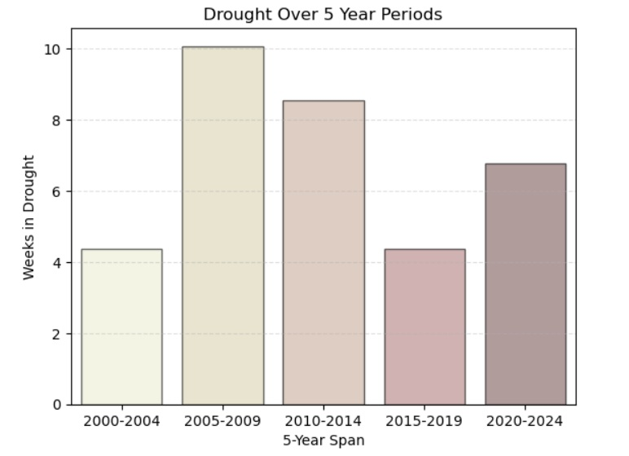
Rainfall and Drought Trends (2000-2024)
Notes:
Let’s take a closer look at that now, focusing on rainfall and drought patterns over the last 25 years.
On the left, you can see again that average rainfall per 5-year period has stayed relatively steady — it fluctuates between about 3.6 and 4.2 inches, showing no major upward or downward trend.
But when we look at the right-hand chart, showing weeks spent in drought, we see a very different pattern. Droughts peaked in the mid-2000s, eased during the late 2010s, and have started to rise again in the early 2020s.
This means that even though rainfall totals look stable, the timing and distribution of that rainfall have become more uneven. We’re getting periods of intense rainfall followed by long dry spells — that’s what we mean by increased variability.
For agriculture, this volatility can be more challenging than an actual change in total rainfall. You might have fields that are too wet to plant one spring, and then too dry to support crops the next. Plants don’t just need a certain amount of water — they need it at the right times. So, the big takeaway here is that water management — things like drainage, soil moisture retention, and irrigation planning — is becoming increasingly important, even in regions that aren’t technically “getting drier.”

Slide 10
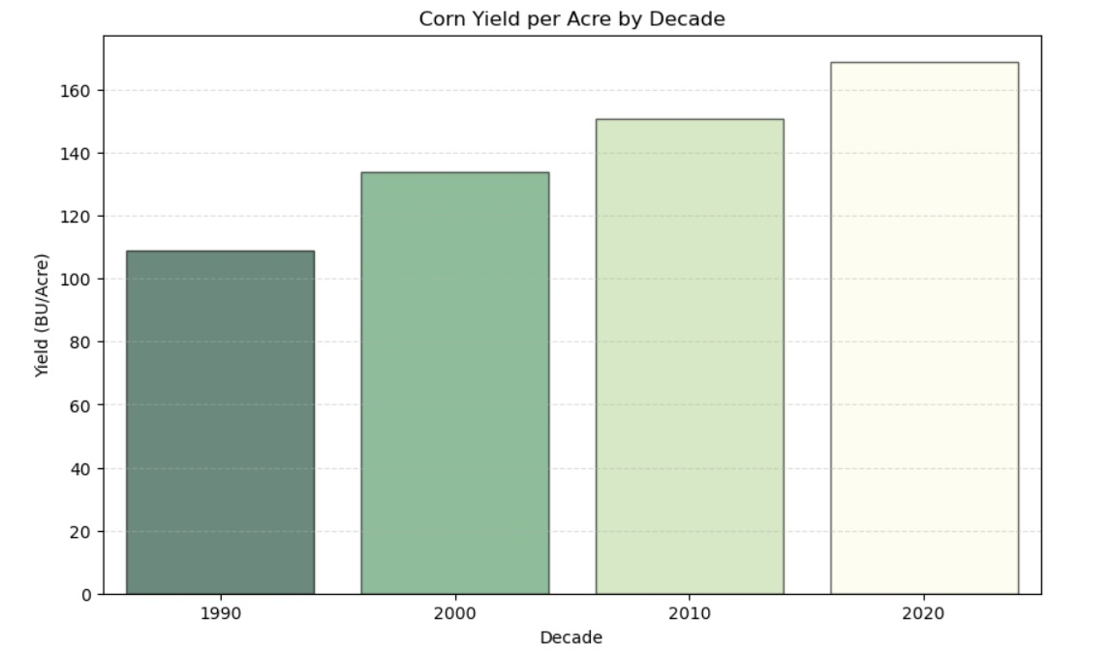
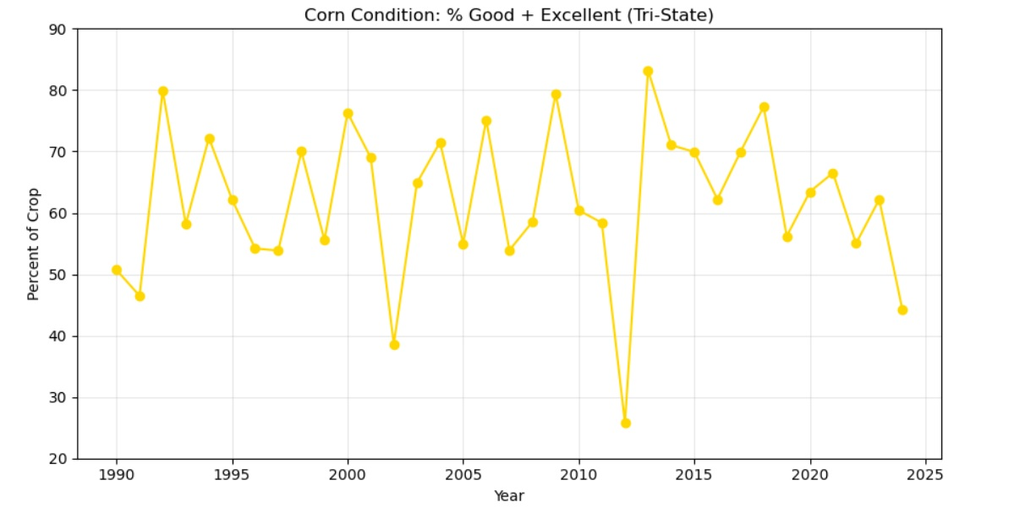
Corn Yield & Condition (Tri-State Region)
Rising yields over recent decades
Variable conditions reflect weather extremes
Crop resilience remains strong overall
Notes:
Let’s take a moment now to connect the weather data we’ve looked at so far with some real outcomes — specifically how these patterns are affecting corn production in our region.
On the left, you can see that corn yields have steadily increased over the past few decades. That’s largely thanks to advancements in agricultural technology, improved hybrids, and management practices that make crops more efficient and resilient. Warmer growing seasons have also played a role by extending the number of frost-free days, which gives crops more time to mature.
But when we look at the chart on the right — which tracks the percentage of the crop rated “Good to Excellent” — we start to see how variable weather affects year-to-year performance. Those sharp dips in condition usually line up with extreme weather events — especially years with drought, flooding, or high heat stress during pollination.
So even though overall yields are trending upward, the consistency of those yields can still fluctuate quite a bit depending on weather volatility. In other words, farmers might be producing more bushels per acre on average, but some years still take a big hit depending on how severe the conditions are.
The good news is that corn has proven to be a remarkably resilient crop, capable of bouncing back quickly in favorable years. But these patterns show just how closely production is tied to climate — and how small shifts in temperature or rainfall can ripple through to affect not just yields, but also crop quality and profitability.

Slide 11
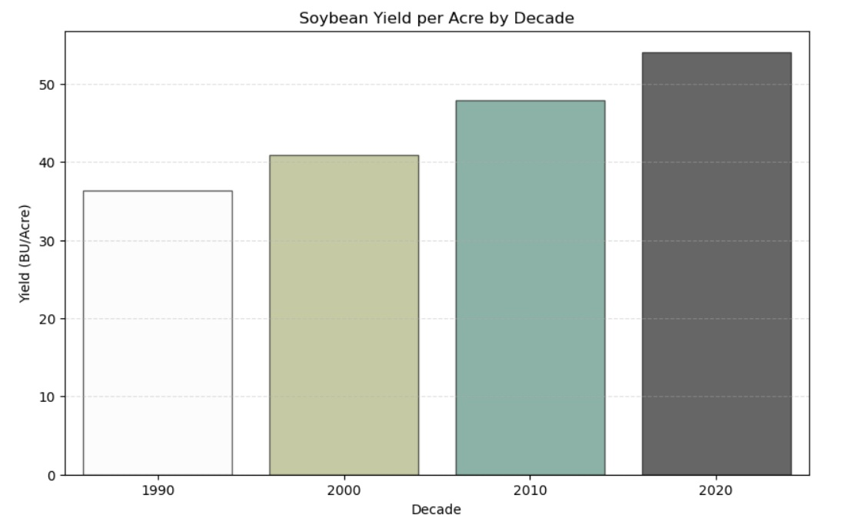
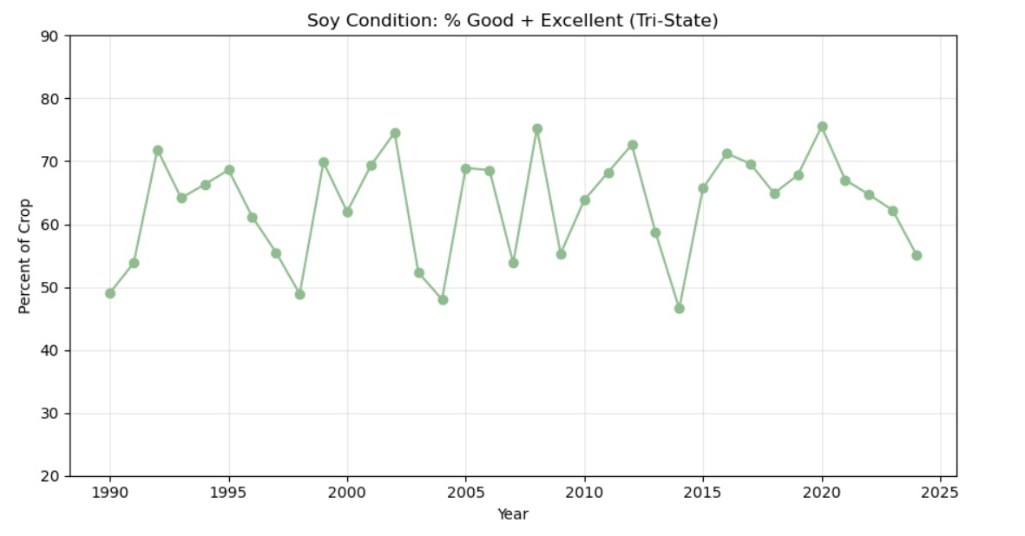
Soy Yield & Condition (Tri-State Region)
Yields rising steadily across decades
Conditions vary widely year to year
Resilient trend despite fluctuations
Notes:
Soybeans tell a very similar story to corn. Just like with corn, we see that soybean yields have risen steadily over the decades. Advances in seed genetics, improved management, and longer growing seasons have all helped push production higher over time. Even with the ups and downs in yearly weather, the overall trend is clearly upward.
On the right, we can also see swings in the soy harvest condition, but what’s interesting here is that soybeans tend to show a bit more resilience than corn under stress. They can recover better from short dry spells or flooding, which makes them an important stabilizing crop in a changing climate.
So, when we look at corn and soybeans together, we see the same basic pattern — steady long-term growth in yield, but lots of year-to-year variability in condition. Both crops highlight how adaptation and innovation have helped maintain productivity, even as weather pressures have become less predictable. In short, these trends show that farmers are already adapting — through technology, better timing, and crop choices — but the increasing climate stress makes it clear that this kind of adaptation will have to keep evolving.

Slide 12




Summary
7a
6b
Notes:
To summarize —
The tri-state region has experienced a measurable northward shift in USDA growing zones between 2012 and 2023 — with about 48% of areas shifting to a warmer zone.
These shifts correspond closely with rising minimum temperatures, which have increased by about 5% since 1990, more than double the rate of increase for overall temperature averages.
Rainfall is more erratic, though totals remain stable. This volatility adds uncertainty for farmers and can affect yield and condition consistency.
Corn and soybean resilience remains strong overall, but vulnerability to extreme weather events is increasing.

Slide 13
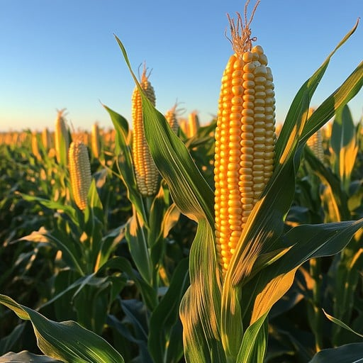





Recommendations
Support Farmers
Early Warning
Diversify Crops
Cooperation
Healthy Soil
Notes:
Based on these findings, here are a few key recommendations:
Support adaptive, climate-smart farming — with drought-tolerant seeds, efficient irrigation, and flexible planting windows.
Invest in early warning and monitoring systems to help farmers predict heat and rainfall extremes.
Diversify crop portfolios by encouraging experimentation with warm-adapted crops or cultivars, which could thrive under the predicted future warming conditions.
Encourage regional cooperation among Kentucky, Ohio, and West Virginia to develop shared adaptation strategies.
Promote soil health practices that protect yield and store carbon. Increasing incentives for practices such as cover cropping and reduced tillage can help maintain agricultural resilience as the region continues to warm.
The tri-state region has shown incredible adaptability already — and that’s something to be proud of. But as we look toward 2050, the changes we’re seeing now will continue to accelerate. The key takeaway is that adaptation isn’t just about reacting — it’s about preparing. Thank you for listening, and I’d be happy to answer any questions.

